Slide 1
JA NFP4Health NFP Profile – How it should be designed and how to cooperate together through a community
WEBINAR
13.06.2023
This presentation is part of the action “NFP4Health” which has received funding from the European Union’s Health Programme (2014-2020) under grant agreement No 101035965.

Slide 2
The National Focal Point IDENTIKIT CARD
This presentation is part of the action “NFP4Health” which has received funding from the European Union’s Health Programme (2014-2020) under grant agreement No 101035965.

Slide 3
REPORT WORKSHOP N. 1
Profile required to deliver the following activities in charge of NFPs:
Provide professional support services for national applicants
Promote HP through the dissemination of its results and impact
Sharing knowledge and good practices among MS and within their national health community
Support the Commission’s implementing services in monitoring the implementation of the actions under the HP
Submit available information on the implementation and impact of the Programme to national bodies
Contribute to the implementation of the Programme through regular cooperation with the Commission’s implementing services
This presentation is part of the action “NFP4Health” which has received funding from the European Union’s Health Programme (2014-2020) under grant agreement No 101035965.

Slide 4
REPORT WORKSHOP N. 1
EXPERIENCE AND DEGREES | Need to define the teamwork concept. Specifically, the need of a team of multidisciplinary experience was highlighted: number of people, years of experience, The team approach could help in the different activities, like: Project Management, EU system, International Experience, Experience in Health, Public Law (EU), Synergies creator, Political Sciences, Sociological Sciences, Medical/Health, International Studies, Economic and Financial Management
 | Info days; Hubs and focus groups organized per health topics; Thematic workshops to inform about synergies; Exchange of best/good practices; Joint events, meetings, and projects; Tailored activities to each group/target.
TECHNICAL SKILLS | A solid knowledge of health system (regional, national, work program) together with project Management and Financing Legal skills (EU laws and policies). analytical and communication skills (for communication, events organization). Language skills (also technical) / language literacy IT skills
 | Full circle approach (collection of data from the territory, further analysis and feedback back to the territory); Exchange of best practices to be adapted in the local areas.
This presentation is part of the action “NFP4Health” which has received funding from the European Union’s Health Programme (2014-2020) under grant agreement No 101035965.

Slide 5
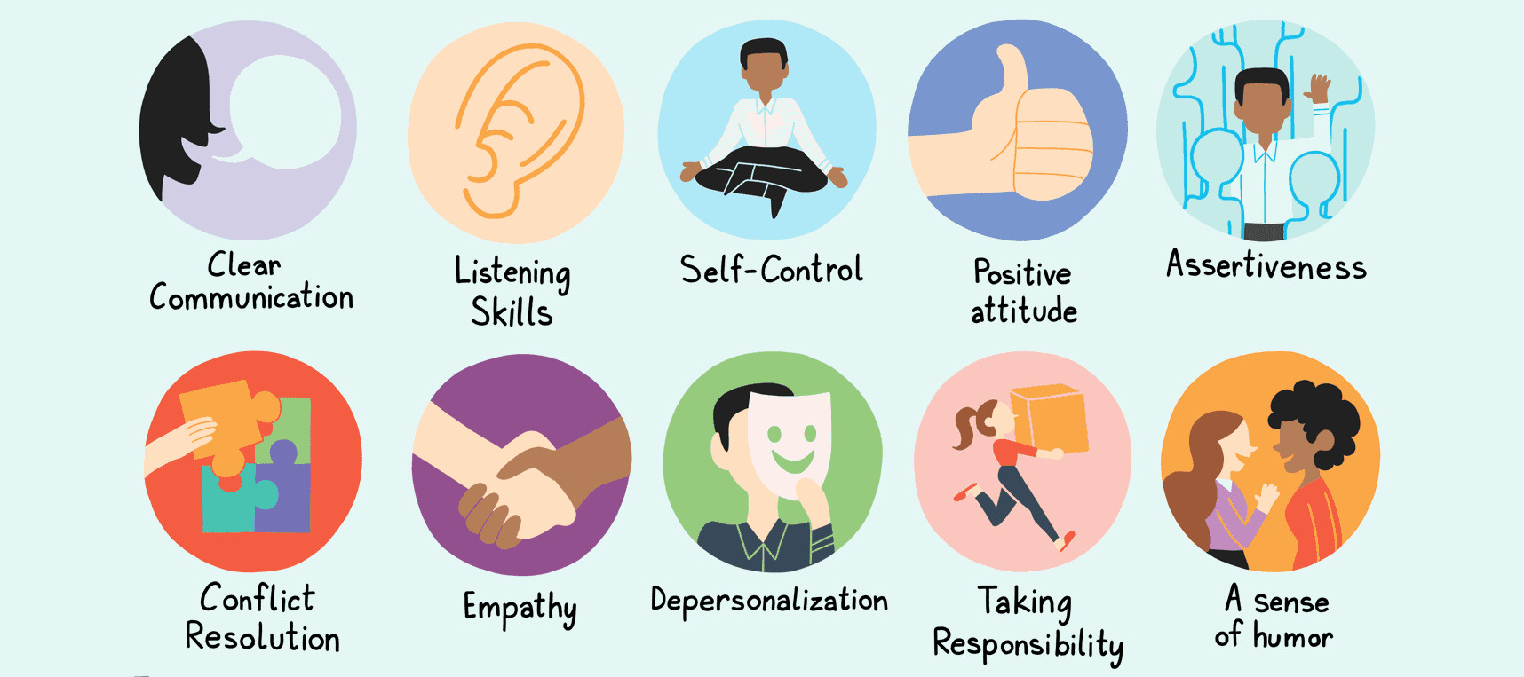
REPORT WORKSHOP N. 1
SOFT SKILLS | Communication: Networking, Stakeholders engagement, search skills to find information, “Translation” skills (able to translate docs and transfer info to different targets and language), Negotiation Organizational: Capacity of guiding stakeholders, Analytical, Communication, Interpretation, Organization and Time Management, Networking, Relationships builder, Strategic thinkers, Coaching, Negotiation. Transparency: Neutral approach, Being diplomatic
 | Info days; Hubs and focus groups organized per health topics; Thematic workshops to inform about synergies; Exchange of best/good practices; Joint events, meetings, and projects; Tailored activities to each group/target.
A NFP PERSON IS… | Curious – Updated - Results Oriented – Flexible - Resilient, Communicative - Easy comprehensive – Pragmatic - Capacity of engage policy makers - Capacity of teamworking, Leadership - training skills - Listening, good connections - ability to attract people and be an influencer - Supportive - Proactive
 | Full circle approach (collection of data from the territory, further analysis and feedback back to the territory); Exchange of best practices to be adapted in the local areas.
This presentation is part of the action “NFP4Health” which has received funding from the European Union’s Health Programme (2014-2020) under grant agreement No 101035965.

Slide 6
REPORT WORKSHOP N. 1
NICE TO HAVE | o Legal background o Having participated in EU projects o Match makers (calls + interest) o Able to think, understand and act quickly
 | Info days; Hubs and focus groups organized per health topics; Thematic workshops to inform about synergies; Exchange of best/good practices; Joint events, meetings, and projects; Tailored activities to each group/target.
 | Full circle approach (collection of data from the territory, further analysis and feedback back to the territory); Exchange of best practices to be adapted in the local areas.
This presentation is part of the action “NFP4Health” which has received funding from the European Union’s Health Programme (2014-2020) under grant agreement No 101035965.

Slide 7
REPORT WORKSHOP N. 1
RESPONSABILITIES | Role and responsibilities of the NFP: The Role of NFP is different in the EU Countries (depending on roles, duties, responsibilities) Transfer of information and synergies, Communication and Dissemination To train and to have good relations with the stakeholders Managing/Organization events Increase the EU project applications Support the Implementation of EU4Health priorities Build a network and share info in both directions Remember that a NFP person is not a NFP only Cooperate with other NFPs to learn
 | Info days; Hubs and focus groups organized per health topics; Thematic workshops to inform about synergies; Exchange of best/good practices; Joint events, meetings, and projects; Tailored activities to each group/target.
 | Full circle approach (collection of data from the territory, further analysis and feedback back to the territory); Exchange of best practices to be adapted in the local areas.
This presentation is part of the action “NFP4Health” which has received funding from the European Union’s Health Programme (2014-2020) under grant agreement No 101035965.

Slide 8
REPORT WORKSHOP N. 2
The organization model of NFPs
A minimum common standards defining the role of National Focal Point
Successful implementation of the EU4Health Programme at national level
Set shared long-term goals and sustainable strategy
A structured synergy among NFPs
Increased sustainability of health systems
Better use of the new areas and instruments of the EU4Health Programme
This presentation is part of the action “NFP4Health” which has received funding from the European Union’s Health Programme (2014-2020) under grant agreement No 101035965.

Slide 9
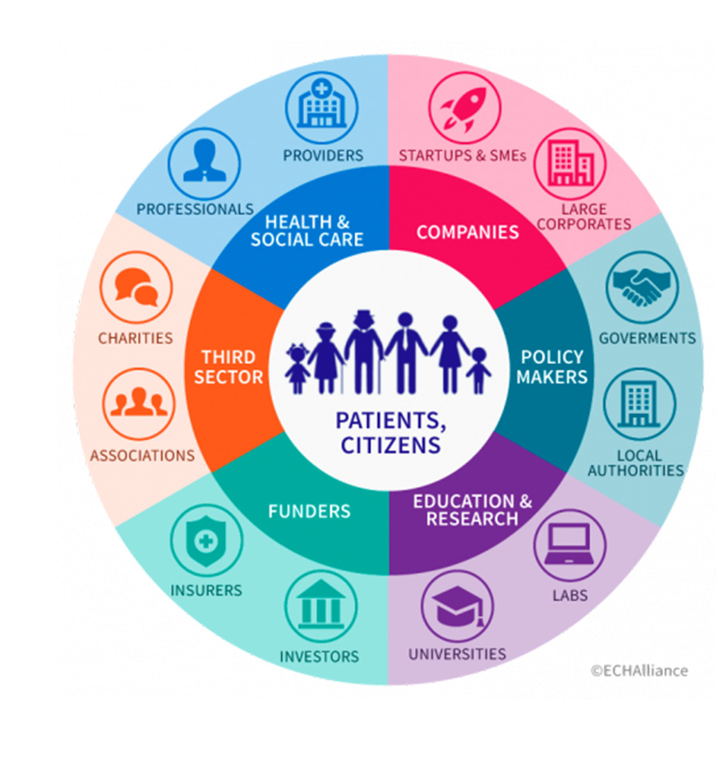
ECOSYSTEMS/STAKEHOLDERS
TYPES OF STAKEHOLDERS/ECOSYSTEMS TO INVOLVE | Funding Institutions; Policy Makers and Public/Governing Bodies; National Care Services, Hospitals, Local Health Authorities; Universities and Research Organizations; NGOs, Professional and Patient Organizations; Industry players
CO-DESIGN PROCESS (HOW THEY CAN WORK TOGETHER) | Info days; Hubs and focus groups organized per health topics; Thematic workshops to inform about synergies; Exchange of best/good practices; Joint events, meetings, and projects; Tailored activities to each group/target.
NEW SYNERGIES WITH OTHER EU FUNDING PROGRAMMES | Cooperation with other NFPs and NCPs (with regular meetings, platforms to exchange information).
CAPACITY OF TRANSFER TO THE LOCAL TERRITORY | Full circle approach (collection of data from the territory, further analysis and feedback back to the territory); Exchange of best practices to be adapted in the local areas.
This presentation is part of the action “NFP4Health” which has received funding from the European Union’s Health Programme (2014-2020) under grant agreement No 101035965.

Slide 10
OBJECTIVES
DEFINE SPECIFIC NEEDS OF THE NFP | Training and information beyond the Work Programme by HaDEA; more direct contact with EU Funding Programmes Representatives; Upskilling and reskilling of HR resources required; Knowledge of tools available and programme structure.
DEFINE THE RELATED SPECIFIC OBJECTIVES | Inform properly and facilitate applicants with accurate info, knowledge of EU Health Programmes, partners’ search to increase the number of successful proposals; Support the EU4Health implementation; Facilitate health policies uptake.
DEFINE THE TARGET TO ADDRESS FOR EACH SPECIFIC OBJECTIVE | Funding bodies: EC (DG, Agencies). Governmental bodies (e.g., Ministries of Health etc.). National applicants. Health ecosystems. Policymakers (EU/national/regional).
This presentation is part of the action “NFP4Health” which has received funding from the European Union’s Health Programme (2014-2020) under grant agreement No 101035965.

Slide 11
ACTIONS & INSTRUMENTS
SUGGESTED ACTIONS AND INSTRUMENTS FOR SYNERGIES/NETWORKING | Networking. Training for communication and dissemination. Training for capacity building. Training modules for NFPs (e.g., videos training short based on QA). Tailored materials.
SUGGESTED ACTIONS AND INSTRUMENTS FOR CAPACITY BUILDING | Training for EU project management and design, finance, project design, etc. Training of training approach (e.g., best practices development). Informal and practical training.
SUGGESTED ACTIONS AND INSTRUMENTS FOR TOOLS AND SERVICES (CROSS-PROGRAMME COLLABORATION) | Common application/joint cloud server to share documents. Mapping of EU Programs. Receiving news and updates.
This presentation is part of the action “NFP4Health” which has received funding from the European Union’s Health Programme (2014-2020) under grant agreement No 101035965.

Slide 12
THANK YOU!
This presentation is part of the action “NFP4Health” which has received funding from the European Union’s Health Programme (2014-2020) under grant agreement No 101035965.

